Slide 1
2D-2D Coordinate Transforms

Slide 2
2D Rigid Frame Transformations
The pose of one 2D frame with respect to another is described by
Translation vector t=(𝚫x, 𝚫y)^{T}
Rotation angle θ
Rotation can also be represented as a 2x2 matrix R
y’
y
x’
Object shape and size is
preserved
t
θ
x
Number of degrees of freedom for a 2D rigid transformation?

Slide 3
Rotations in 2D
Let’s derive the formula for a 2D rotation
y
y’
x’
θ
x

Slide 4
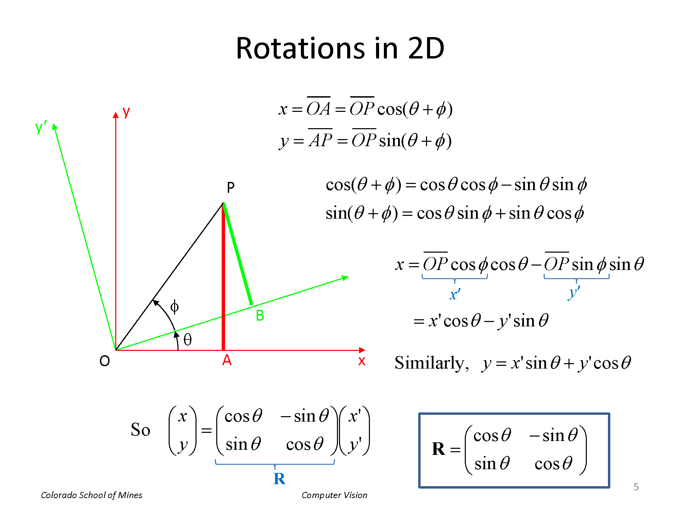


Slide 5
Rotations in 2D
x
y
x’
y’
cos 𝜃 sin 𝜃
— sin 𝜃 cos 𝜃
y
= 𝐑
𝐑 =
y’
R describes the orientation of the “primed” frame (x’,y’) with respect to the “unprimed” frame (x,y)
R is orthonormal
Rows, columns are orthogonal (r₁∙r₂ = 0, c₁∙c₂ = 0)
Transpose is the inverse;
RR^{T} = I
Determinant is |R| = 1
x’
θ
x
x’
y’
= 𝐑^{T}
x
y

Slide 6

Homogeneous Coordinates
Points can be represented using homogeneous coordinates
This simply means to append a 1 as an extra element
If the 3rd element becomes ≠ 1, we divide through by it
Effectively, vectors that differ only by scale are considered to be equivalent
This simplifies transform equations; instead of
𝐱′ = 𝐑𝐱 + t
we have
𝐱′ = 𝐇𝐱
𝐱 ∈ 𝑃², where 𝑃² = 𝑅³ – (0,0,0) is called a 2D projective space

Slide 7
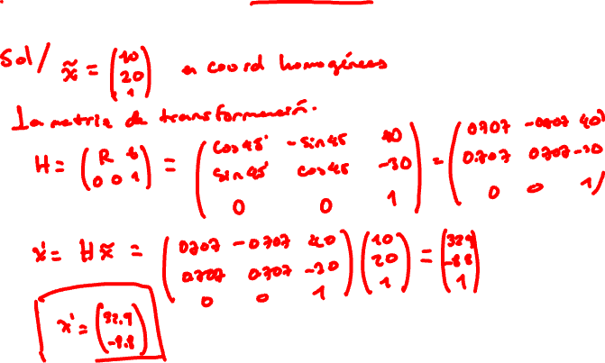
Example
Transform the 2D point x = (10, 20)^{T} using a rotation
of 45 degrees and translation of (+40, -30).
8

Slide 8
Example
Transform the 2D point x = (10, 20)^{T} using a rotation of 45
degrees and translation of (+40, -30).
Solution:
The point in homogeneous coords is
The transformation matrix is
~x = (10,20,1)^{T}
⎛cos 45
sin 45 cos 45
0
40 ⎞ ⎛.707
−.707 40 ⎞
⎟
.707 − 30⎟
0
{A}
{B}
⎛ R t ⎞
⎜
⎟ ⎜
H = ⎜⎜
⎟⎟ = ⎜ sin 45
− 30⎟ = ⎜.707
⎝ 0 0 1⎠
⎜
⎟ ⎜
⎟
⎝
0
1
⎠ ⎝
0
1
⎠
– Transforming the point:
B _{R}
A
⎛.707
−.707 40 ⎞⎛10 ⎞
.707
0
⎛ 32.9 ⎞
describes the orientation of A with respect to B
⎜
⎟⎜ ⎟ ⎜
⎟
H~x = ⎜.707
− 30⎟⎜ 20⎟ = ⎜− 8.8⎟
⎜
0
1
⎟⎜ ⎟ ⎜
⎟
{B}
⎝
⎠⎝ ¹ ⎠ ⎝
1
⎠
{A}

Slide 9



Other 2D-2D Transforms
Scaled (similarity) transform
– preserves angles but not distances
Affine transform
– Models rotation, translation, scaling, shearing, and reflection
# pairs of corresponding points needed?

Slide 10
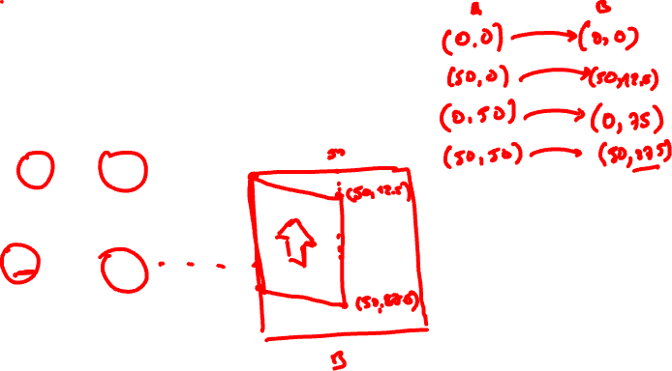
Example
Image “A” is modified by the affine transform below. Sketch image “B”
0,0
50,0
0,50
50,50
A

Slide 11
Example
Image “A” is modified by the affine transform below. Sketch image “B”
0,0
50,0
0,50
50,50
A

Slide 12
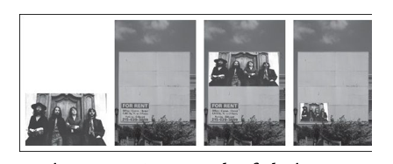
Example Affine Warp
An example of placing an image inside another image using an affine transformation.
Solem, Jan Erik. Programming Computer Vision with Python: Tools and algorithms for analyzing images.

Slide 13
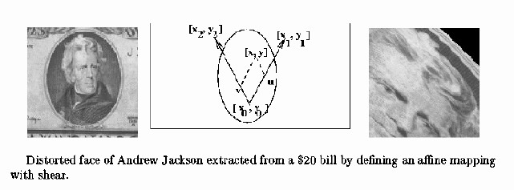
Example Affine Warp
from http://www.cse.msu.edu/~stockman/CV

Slide 14


Projective Transform (Homography)
Most general type of linear 2D-2D transform
•
H is an arbitrary 3x3 matrix
We still need to divide by the 3rd element
As we will see later, a homography maps points from the projection of one plane to the projection of another plane

Slide 15
From Szeliski, Computer Vision: Algorithms and Applications

